Slide 1
Objective :
To estimate the software production effort and minimize the difference between measured effort and estimated effort avoid the loss that may occur due to irregular cost estimations and avoid the loss that may occur due to irregular cost estimations .

Slide 2
Introduction
Software Cost estimation is a process of predicting the effort required to develop a Software Product, that helps in identifying project risks and provides an option to discuss alternatives if new requirements are needed to be added.
The main factors to be considered while calculating project costs are: Size of Product ,Manpower, Materials, Equipment, Premises, Service Providers ,Network Providers ,etc.,
The accurate project costing plan enables one to weigh anticipated benefits against anticipated costs to assess if the project makes sense.

Slide 3
The Constructive Cost Model is a procedural software cost estimation model developed by Barry W. Boehm.
The model parameters are derived from fitting a regression formula using data from 63 software historical projects .
This model uses four parameter (a,b,c,d)with DLOC and methodology to compute the effort as follows:
EE=a x (DLOC)^{b} +c x M +d
Where a - cost drivers/ multipliers,
b - scale factors
c & d - schedule constants
M is Methodology and
DLOC is the size of the project
The values of a,b,c,d values are a=2.94,b=0.91 }Baseline Effort Constants
c=3.67,d=0.28 }Baseline Schedule Constants

Slide 4
Problem Statement:
Considering Man-Power as the factor, estimating the Software Production Effort more accurately and reduce the difference between the expected cost and the actual cost of the Product.

Slide 5
Proposed Approach:
Sheta proposed an evolutionary model using genetic algorithms .
He used GA for the estimation of the parameters of the COCOMO effort estimation model
Using Parameterized approach proposed by Sheta, estimating the software effort by tuning the parameters till we get an optimized output.
IEAM – RP ,an evolutionary method is going to used for tuning the parameters
Search Domain for a {0, 10}
Search Domain for b {0.3, 2}
Search Domain for c {-0.5, 0.5}
Search Domain for d {0, 20}.
The objective of the proposed technique is to tune the above parameters that provide most accuracy in cost estimation.

Slide 6
IEAM-RP Method:
IEAM-RP is one of the evolutionary algorithms , found recently, that is used to solve single objective optimization problems.
It is a variant of EAM which works with real numbers.
The performance of the suggested algorithm was checked using various functions of COCOMO framework.
The performance of IEAM-RP was found quite satisfactory in tuning the parameters to get optimized solution.

Slide 7
Principle of IEAM-RP:
The algorithm is based on the principle of adaptive learning.
This algorithm achieves the principle of adaptive learning using its operators, adaption and selection .
It can be categorized into four Phases
1. Initialization Phase
2. Adaption Phase
3. Offspring Generation Phase
4. Selection Phase
The steps 2-4 are iterated till an ideal effort is estimated.

Slide 8
After estimating the software effort of an product , we calculate the error by comparing the estimated effort with the measured efforts .
Magnitude of the error is calculated using:
MRE=abs(measured effort-estimated effort) /
measured effort
Fitness function is used to determine the best outcome from the population
Average of MRE over the observations is used as the fitness function(F avg)

Slide 9
In order to create oﬀ-spring, adaptation operator divides the population into two classes.
One class contains only one(best) solution , whereas another class contains remaining solutions.
The best solution updates its position vector using its personal ﬁtness and average ﬁtness of the population as follows:
Pb+1 = Pb ×F(Pb)/Favg + β
Here, β is a random value between 0 to 1.
The remaining solutions receive the direction from the best solution and try to achieve a better phenotypic structure in the problem search space as follows:
Pnb+1 = Pnb + β×(best_position−worst_position)

Slide 10
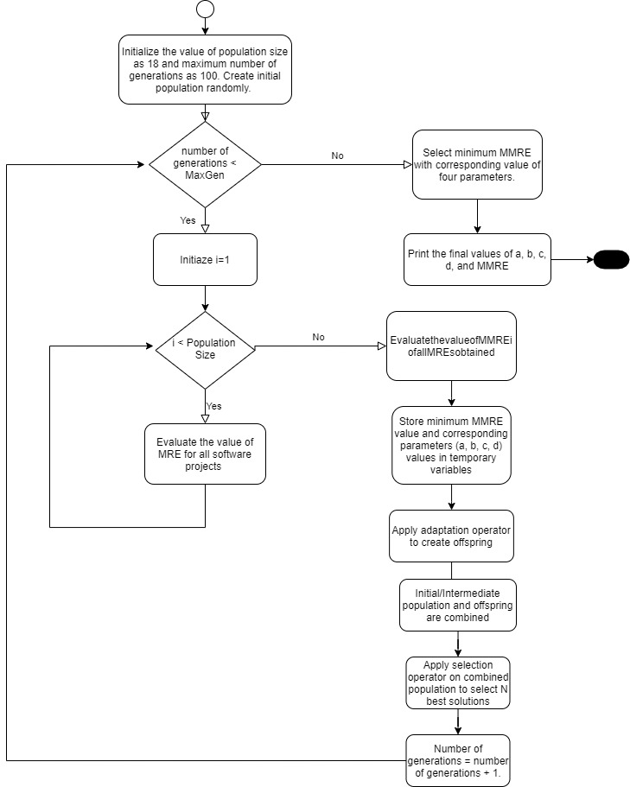

Slide 11
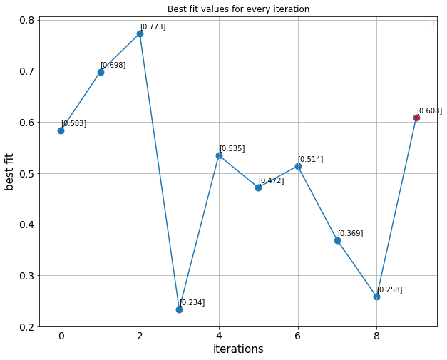
Sample Output:
Best MMRE= 0.234
Best data [0.156, -0.294, 0.209, 0.822]

Slide 12
Conclusion:
Using the final parameter values obtained by tuning multiple times ,the cost of the software product can be measured with greater accuracy .
Thus, the inaccuracy in estimation of the software development cost can be reduced and the losses due to faulty effort estimations can be minimized to a greater extent .

Slide 13
Thank you…..

